Slide 1

Big Data Hadoop
ADITYA TIWARI
RA1611003030164
Eckovation Solutions Pvt. Ltd.

Slide 2
About Eckovation
A Social Learning platform: Making quality education available to all
People at Eckovation are passionate about connecting students, educators, peers, corporations and workers to enable dissemination of knowledge and information and thereby making quality education and skill development accessible for students and workers across the country. Through our application, we hope to improve the lives of millions of students who have the desire and will to succeed. Our platform is a confluence point of various ideas by all the stakeholders involved in the teaching and attainment of knowledge process. We believe in the concept of collaborative education which involves the interplay of all the stakeholders and strive to make a lasting impact in the lives of our users and stakeholders.

Slide 3
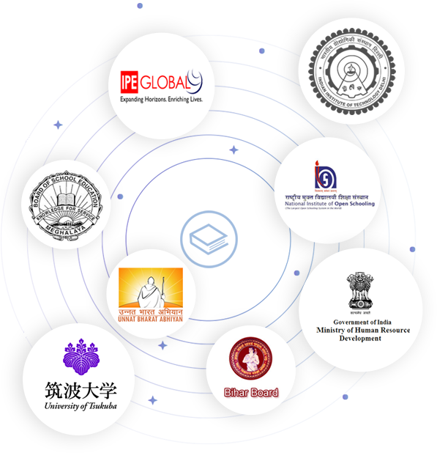
BUSINESS PARTNERS IPE Global IIT Delhi Ministry of Human Resource Development (MHRD) National Institute of Open School (NIOS) University of Tsukuba, Japan and several more...

Slide 4
What is BIG DATA ?
Big data means really a big data, it is a collection of large datasets that cannot be processed using traditional computing techniques. Big data is not merely a data, rather it has become a complete subject, which involves various tools, techniques and frameworks.
Data which are very large in size is called Big Data. Normally we work on data of size MB or maximum GB(Movies, Codes) but data in Peta bytes i.e. 10^15 byte size is called Big Data. It is stated that almost 90% of today's data has been generated in the past 3 years.

Slide 5
Applications of big data.
Areas | Big Data applications
Targeting customers | Big Data helps understanding customers and target them in personalized fashion.
Science and Research | Big Data helps make machines smarter. For example, Google’s Self-driving cars
Security | Big Data is used to keep track of the terrorists and anti-national agencies
Finance | Big Data algorithms are used to analyze market and trading opportunities

Slide 6
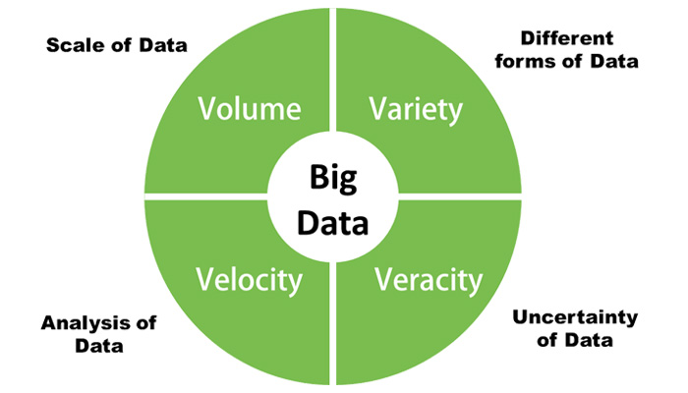
Big Data has certain characteristics and hence is defined using 4Vs namely:

Slide 7
Continued…
Volume : the amount of data that businesses can collect is really enormous and hence the volume of the data becomes a critical factor in Big Data analytics.
Velocity : the rate at which new data is being generated all thanks to our dependence on the internet, sensors, machine-to-machine data is also important to parse Big Data in a timely manner.
Variety : the data that is generated is completely heterogeneous in the sense that it could be in various formats like video, text, database, numeric, sensor data and so on and hence understanding the type of Big Data is a key factor to unlocking its value.
Veracity: knowing whether the data that is available is coming from a credible source is of utmost importance before deciphering and implementing Big Data for business needs.

Slide 8
Apache Hadoop
Apache Hadoop is a Big Data framework that is part of the Apache Software Foundation. Hadoop is an open source software project that is extensively used by some of the biggest organizations in the world for distributed storage and processing of data on a level that is just enormous in terms of volume. That’s the reason the Apache Hadoop runs its processing on large computer clusters built on commodity hardware. Some of the features of the Hadoop platform are that it can be efficiently used for data storage, processing, access, analysis, governance, security, operations and deployment.
The idea of Apache Hadoop was actually born out of a Google project called the MapReduce, which is a framework for breaking down an application into smaller chunks that can then be parsed on a much smaller and granular level.

Slide 9
Modules of Hadoop
HDFS: Hadoop Distributed File System. Google published its paper GFS and on the basis of that HDFS was developed. It states that the files will be broken into blocks and stored in nodes over the distributed architecture.
Yarn: Yet another Resource Negotiator is used for job scheduling and manage the cluster.
Map Reduce: This is a framework which helps Java programs to do the parallel computation on data using key value pair. The Map task takes input data and converts it into a data set which can be computed in Key value pair. The output of Map task is consumed by reduce task and then the out of reducer gives the desired result.

Slide 10
Advantages of Hadoop
Fast: In HDFS the data distributed over the cluster and are mapped which helps in faster retrieval. Even the tools to process the data are often on the same servers, thus reducing the processing time. It is able to process terabytes of data in minutes and Peta bytes in hours.
Scalable: Hadoop cluster can be extended by just adding nodes in the cluster.
Cost Effective: Hadoop is open source and uses commodity hardware to store data so it really cost effective as compared to traditional relational database management system.
Resilient to failure: HDFS has the property with which it can replicate data over the network, so if one node is down or some other network failure happens, then Hadoop takes the other copy of data and use it. Normally, data are replicated thrice but the replication factor is configurable.

Slide 11
MapReduce
MapReduce is the framework that is used for processing large amounts of data on commodity hardware on a cluster ecosystem. The MapReduce is a powerful method of processing data when there are very huge amounts of node connected to the cluster. The two important tasks of the MapReduce algorithm are, as the name suggests – Map and Reduce.

Slide 12
Steps in Map Reduce
Map takes a data in the form of pairs and returns a list of <key, value> pairs. The keys will not be unique in this case.
Using the output of Map, sort and shuffle are applied by the Hadoop architecture. This sort and shuffle acts on these list of <key, value> pairs and sends out unique keys and a list of values associated with this unique key <key, list(values)>.
Output of sort and shuffle will be sent to reducer phase. Reducer will perform a defined function on list of values for unique keys and Final output will <key, value> will be stored/displayed.

Slide 13
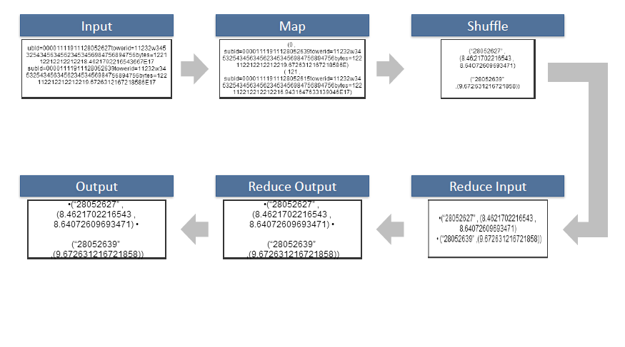
Continued…

Slide 14
What is Pig ?
Apache Pig is a high level data flow platform for execution Map Reduce programs of Hadoop. The language for Pig is pig Latin.
The Pig scripts get internally converted to Map Reduce jobs and get executed on data stored in HDFS. Every task which can be achieved using PIG can also be achieved using java used in Map reduce.

Slide 15
Usage of Pig
Ease of programming: Writing complex java programs for map reduce is quiet tough for non programmers. Pig makes this process easy. In pig, the queries are converted to map reduce internally.
Optimization opportunities: The way in which tasks are encoded permits the system to optimize their execution automatically, allowing the user to focus on semantics rather than efficiency.
Extensibility: User defined function are written in which the user can write their own logic to execute over the data set.

Slide 16
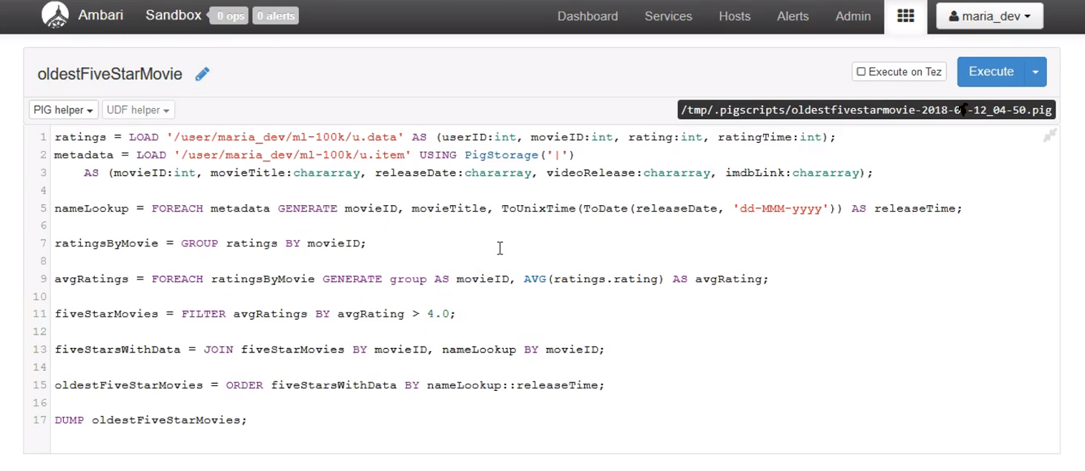
Pig Script Example
To find the oldest five star movie,
Dataset to be used : movielens dataset

Slide 17
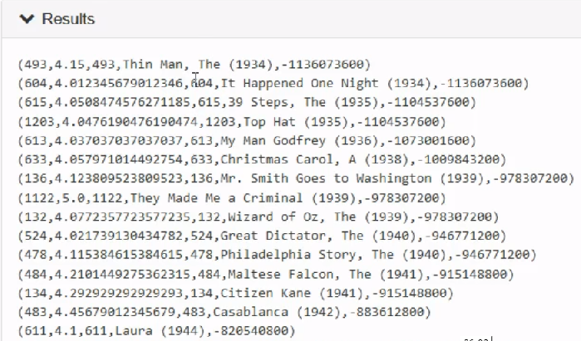
Output

Slide 18


